Slide 1
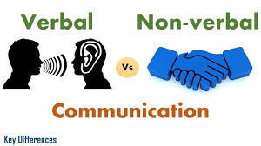
NON VERBAL COMMUNICATION -I
Dept. of HSS, JIIT, Noida

Slide 2
Topics to be covered
What comes under Nonverbal Communication?
Types of Non Verbal Behaviour.
Tips for reading Body Language
Resources to be consulted for further reading:
Chaturvedi. P.D ( 2011). Business Communication: Concepts, Cases, and Applications, Second edition, Pearson Education India.
Its online availability site: https://docs.google.com/viewer?a=v&pid=sites&srcid=ZGVmYXVsdGRvbWFpbnxvbGVya2RyZXN8Z3g6MjU4MTc4NTNmMTdjMWVjNg

Slide 3
Nonverbal can include:
Shaking hands
Posture
Facial expressions
Appearance
Voice, Tone, Hairstyle, Clothes
Expression in your eyes, smile,
How close you stand to others, how you listen
Confidence, your breathing, the way you move, the way you stand, the way you touch people
Color choice
Silence

Slide 4
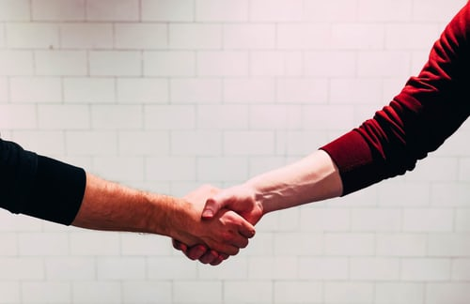
A Firm/ Assertive Hand Shake

Slide 5
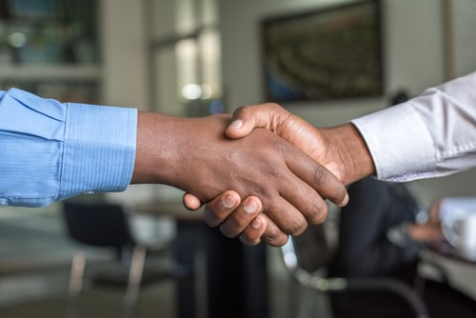
A passive handshake

Slide 6

A friendly hand shake

Slide 7
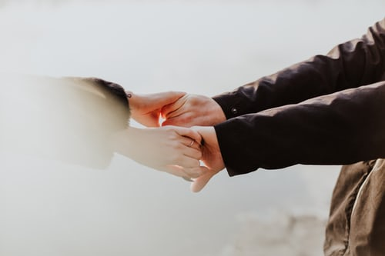
A warm hand shake

Slide 8
Types of nonverbal behavior
Proxemics
Haptics
Chronemics
Kinesics
Artifacts
Vocalics or Paralanguage
Cultural Influence

Slide 9
Proxemics (space)
Have you ever felt uncomfortable during a conversation because the other person was standing too close and invading your space? (example from students)
We all have a need for physical space, although that need differs depending on the culture, the situation, and the closeness of the relationship.
The space between the sender and the receiver of a message influences the way the message is interpreted.
Different cultures have different comfort levels of distance
As children grow older, they become less dependent on parents and require more space
You can use physical space to communicate many different nonverbal messages, including signals of intimacy and affection, aggression or dominance (examples from students)

Slide 10
Haptics (touch)
We communicate a great deal through touch. Think about the very different messages given by a weak handshake, a warm bear hug, a patronizing pat on the head, or a controlling grip on the arm, for example.
(examples from students)
It is the study of touching as nonverbal communication, and haptic communication refers to how people and other animals communicate via touching.
Touches among humans can be defined as communication include handshakes, holding hands, kissing, back slapping, high fives, a pat on the shoulder, and brushing an arm.

Slide 11
CHRONEMICS (time)
Chronemics is the study of the use of time in nonverbal communication. The way that an individual would perceive and value time, structure his/her time and react to time is a powerful communication tool, and helps set the stage for the communication process.

Slide 12
Time perceptions include:
punctuality,
willingness to wait, and
interactions.
The use of time can affect:
lifestyles,
daily agendas,
speed of speech,
movements and
how long people are willing to listen

Slide 13
Kinesics (movement)
It is the study how people communicate through posture, gesture, stance, and movement.
Bodily action
Gestures
Eye Contact (In virtual classes, one need to look at the camera.)
Facial Expressions
Posture

Slide 14
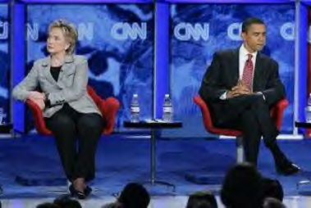


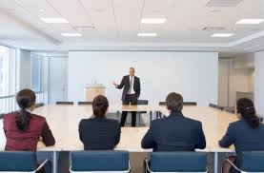

Slide 15
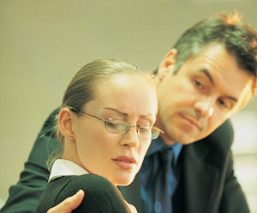
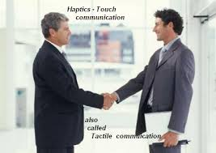
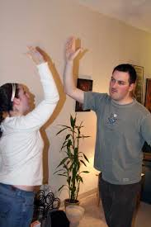
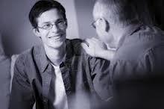

Slide 16
Artifacts
Artifacts are:
Physical objects, such as clothing, homes, and cars
Through these objects “Messages are thus conveyed in a nonverbal manner” (DeVito, 2005)
Many people tend to overlook the actual meaning of such an adornment.
Notes:
https://www.google.com/search?sxsrf=ALeKk00Vadw02-mFEqKMvq8WiYP-fVAo_A%3A1598762136852&source=hp&ei=mCxLX9iCMtKf9QOqlLPgDw&q=artifacts+in+nonverbal+communication+definition&oq=&gs_lcp=CgZwc3ktYWIQARgAMgcIIxDqAhAnMgcILhDqAhAnMgcIIxDqAhAnMgcIIxDqAhAnMgcIIxDqAhAnMgcIIxDqAhAnMgcIIxDqAhAnMgcIIxDqAhAnMgcIIxDqAhAnMgcIIxDqAhAnUABYAGDsImgBcAB4AIABAIgBAJIBAJgBAKoBB2d3cy13aXqwAQo&sclient=psy-ab

Slide 17
Vocalics or Paralanguage
“Paralanguage, also known as vocalic, is a component of meta-communication that may modify meaning, give nuanced meaning, or convey emotion, by using techniques such as prosody, pitch, volume, intonation, etc. It is sometimes defined as relating to no phonemic properties only”. Elements of language such as:
Voice
Speed
Pitch
Pause
Volume
Stress and tone comprise paralanguage.
Notes:
https://www.google.com/search?sxsrf=ALeKk01l2KjmjhSp9uH4fawk5M8OLNu1MQ%3A1598762247255&ei=By1LX4ibD4G5rQGt3474Bg&q=vocalics+or+paralanguage&oq=Vocalics+or+Paralanguage&gs_lcp=CgZwc3ktYWIQARgAMgIIADIICAAQFhAKEB5QrespWK3rKWCBqypoAHAAeACAAc0CiAHNApIBAzMtMZgBAKABAqABAaoBB2d3cy13aXrAAQE&sclient=psy-ab

Slide 18
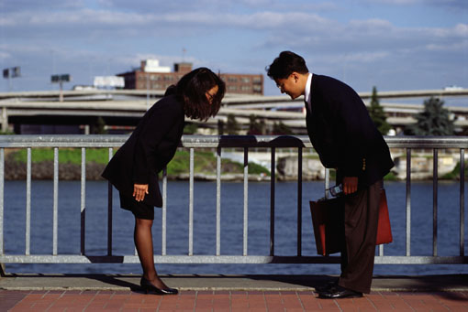
CULTURAL INFLUENCES
Non verbal signals vary form culture to culture

Slide 19

In the United States it is a symbol for good job
In Germany the number one
In Japan the number five
In Ghana an insult
In Malaysia the thumb is used to point rather than a finger

Slide 20
TIPS FOR READING BODY LANGUAGE
Pay attention to inconsistencies
Look at nonverbal communication signals as a group: don’t read too much in signal gesture.
All the gestures should be taken into together
Trust your instincts

Slide 21
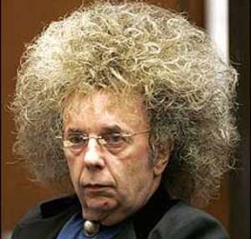
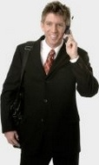
What message is given by their appearances?

Slide 22
Color Influences Communication
Yellow cheers
and
elevates moods
Red excites
and
stimulates
Blue comforts
and
soothes
In some
cultures
black suggests
mourning
In some
cultures
white suggests
purity

Slide 23
A FEW IMAGES OF NONVERBAL CUES

Slide 24
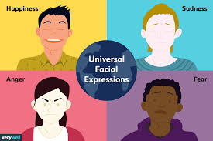

Slide 25


Slide 26
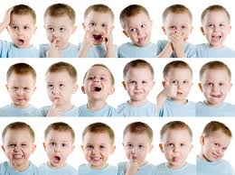
Facial Expressions

Slide 27
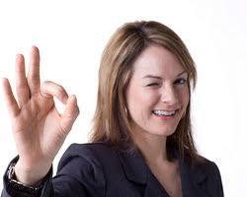
What does it mean?

Slide 28


Slide 29
Links for videos on Non-Verbal Cues
https://www.youtube.com/watch?v=SKhsavlvuao
https://www.youtube.com/watch?v=E6NTM793zvo
https://www.youtube.com/watch?v=fLaslONQAKM

Slide 30
Learning Outcome
Apply the acquired skills in delivering effective presentations
Non Verbal Communication: Body Language, Voice Modulation, Posture

Slide 31
Relevance
The relevance of Nonverbal communication lies in the facts that
It is very important for the students to understand the process of shared cues among people
It also goes hand-in-hand with public speaking.
It will increase the students’ trust, confidence, clarity, and interest to their presentations and public speaking.

Slide 32
MCQ (Choose the right answer and write)
Non-verbal communication includes all external stimuli apart from words uttered. a) True b) False
2. Which of these is not an element of non- verbal communication?
a. Personal appearance b. Posture c. Eye contact d. Name of the speaker
3. Someone asks you for directions and you point the way they wish to travel. This is an example of nonverbal
Substitution b. regulation c. complementing d. contradiction
4. The fact that it is impossible to fix common meaning on all nonverbal messages indicates that nonverbal communication is a. ambiguous b. multi-channelled c. non-linguistic. d. continuous.
5. Someone gives you eye contact, allowing you to speak in the classroom. This is an example of nonverbal
a.Contradiction b. regulation c. complementing d. substitution

Slide 33
References
https://www.google.com/search?q=images+for+non+verbal+communication&sxsrf=ALeKk01yI3wTvjmjVulLSODD-hf-FZC8WQ:1598609392742&tbm=isch&source=iu&ictx=1&fir=OZ_3r0ZKJFWtLM%252CbXDdDQYLF_SggM%252C_&vet=1&us
https://culturechallenges.wordpress.com/2014/11/25/144/
https://www.slideshare.net/bartlettfcs/american-family-communication
https://open.lib.umn.edu/communication/chapter/4-1-principles-and-functions-of-nonverbal-communication/
S. Kumar and Pushp Lata, Communication Skills, Oxford University Press,1st, Ed. 2011
Google images and youtube videos
The Importance of Effective Communication, Edward G. Wertheim, Ph.D.
https://askanydifference.com/difference-between-verbal-and-non-verbal-communication/

Slide 34
Three elements of communication
https://www.google.com/search?q=three+elements+of+communication&sxsrf=ALeKk02xCVcke2e_1zLs3-JTIc1j39eOnQ:1598529388024&tbm=isch&source=iu&ictx=1&fir=WrEBTK4jxhcyyM%252ClRaGFzF5qNOLqM%252C_&vet=1&usg=AI4_-kQ8BWknn3Tqx4V08XXNyvq5THWkvw&sa=X&ved=2ahUKEwin9deCqrvrAhUizDgGHS5TBNkQ_h16BAgKEAg#imgrc=WrEBTK4jxhcyyM
For appearance
https://www.google.com/search?q=non+verbal+images+for+appearance&rlz=1C1CHBD_enIN905IN905&sxsrf=ALeKk009uMdutjtmBYgIUfLxKXmi5VFZQA:1598609950778&tbm=isch&source=iu&ictx=1&fir=ZkKG2iRG_OE5PM%252CxExR6NC_O7p_oM%252C_&vet=1&usg=AI4_-kQHxeKOfIgcr5FvOCThlHXUpZkWMA&sa=X&ved=2ahUKEwjK7f-R1r3rAhVCzjgGHWEJDx4Q9QF6BAgKEB4#imgrc=OXp4reFMlc40VM
https://www.pinterest.com/azeytez/career-wear/
https://www.pinterest.com/pin/466474473899045177/
For hand shake
https://www.google.com/search?q=hand+shake+image&tbm=isch&ved=2ahUKEwiN9Kn42L3rAhV3hUsFHbsaABcQ2-cCegQIABAA&oq=hand+shake&gs_lcp=CgNpbWcQARgBMgUIABCxAzICCAAyAggAMgIIADICCAAyAggAMgIIADICCAAyAggAMgIIADoECAAQQzoHCAAQsQMQQ1CjJFiIpgFgv8cBaABwAHgAgAHJAYgBlg6SAQUwLjguMpgBAKABAaoBC2d3cy13aXotaW1nwAEB&sclient=img&ei=Dt1IX421DveKrtoPu7WAuAE&rlz=1C1CHBD_enIN905IN905
https://www.brighthr.com/articles/contracts/employee-contract-rights/
https://medium.com/@Ibn_al_tagir/has-recommended
https://www.pinterest.com/pin/45387908730312460/
https://unsplash.com/s/photos/holding-hands

Slide 35
Kinesics
https://www.latimes.com/nation/politics/la-na-hillary-clinton-nevada-union-20150503-story.html
https://2012books.lardbucket.org/books/a-primer-on-communication-studies/s04-nonverbal-communication.html
https://slideplayer.com/slide/10381035/
https://www.google.com/url?sa=i&url=http%3A%2F%2Fdixon-law.com%2FAreas-Of-Practice%2Fdiscrimination-claims%2F&psig=AOvVaw3vNphVmq-U4ebzyyW74e4p&ust=1598726433388000&source=images&cd=vfe&ved=0CA0QjhxqFwoTCNi1hJvGvusCFQAAAAAdAAAAABAD
https://smashyoursalesquota.com/blogs/blog/sales-motivation-meme
https://growingleaders.com/blog/six-reasons-mentors-tell-failures-stories-and-why-mentees-listen-guest-post-by-regi-campbell/
https://en.wiktionary.org/wiki/high_five
Cultural Influences
https://www.pinterest.com/pin/745416175799283471/
https://www.google.com/url?sa=i&url=https%3A%2F%2Fwww.pinterest.com%2Fpin%2F439241769908303227%2F&psig=AOvVaw2RxNcwZGJgXGa2_kuwpgT7&ust=1598773247482000&source=images&cd=vfe&ved=0CA0QjhxqFwoTCJiV_tb0v-sCFQAAAAAdAAAAABAD

Slide 36
Non-Verbal Cues Images
https://www.verywellmind.com/types-of-nonverbal-communication-2795397
https://us.softbankrobotics.com/blog/the-future-of-natural-language-processing-non-verbal-communication
Facial Expressions
https://www.pinterest.com/pin/443112050808040648/
What does it mean?
http://formatcomunicacion.com/NonverbalCommunication/nonverbal-communication-gestures-examples

